Slide 1
Card Transaction Fraud Monitoring

Slide 2
TEAM MEMBERS
Siyaram Sharma
Abhishek Bapat
Aditya Lad
Satakshi Singh
Shreya Parjane

Slide 3
PROBLEM STATEMENT
A bank operates across multiple digital and physical payment channels, generating a very high volume of card transactions each day.
Continuous arrival of these transactions into cloud storage creates a fast‑moving environment that demands scalable, modern data processing.
Existing systems lack the capability to handle real‑time ingestion, low‑latency processing, and large‑scale analytics efficiently.
Fraud analysts are unable to access timely, trustworthy, analytics‑ready data, limiting effective fraud detection and operational response.
The bank requires a unified Databricks Lakehouse platform that supports scalable ingestion, strong governance, streamlined pipelines, and delivers curated datasets for advanced fraud analytics and BI reporting.

Slide 4
SOLUTION STRATEGY
Adopt the Databricks Lakehouse architecture to unify near–real-time ingestion, scalable processing, governance, and analytics in a single platform.
Ingest streaming transaction files using Auto Loader with Structured Streaming, ensuring continuous, fault‑tolerant, and efficient data flow from cloud storage.
Implement a Bronze–Silver–Gold layered design to separate raw ingestion, refined transformation, and analytics‑ready datasets for fraud monitoring.
Build a governed Gold‑layer star schema (fact + dimension tables) optimized for fraud analytics, reporting, and high‑performance BI queries.
Expose BI‑ready curated data through Databricks SQL Warehouse, integrating with Power BI dashboards to deliver real‑time fraud insights to analysts and business users.

Slide 5
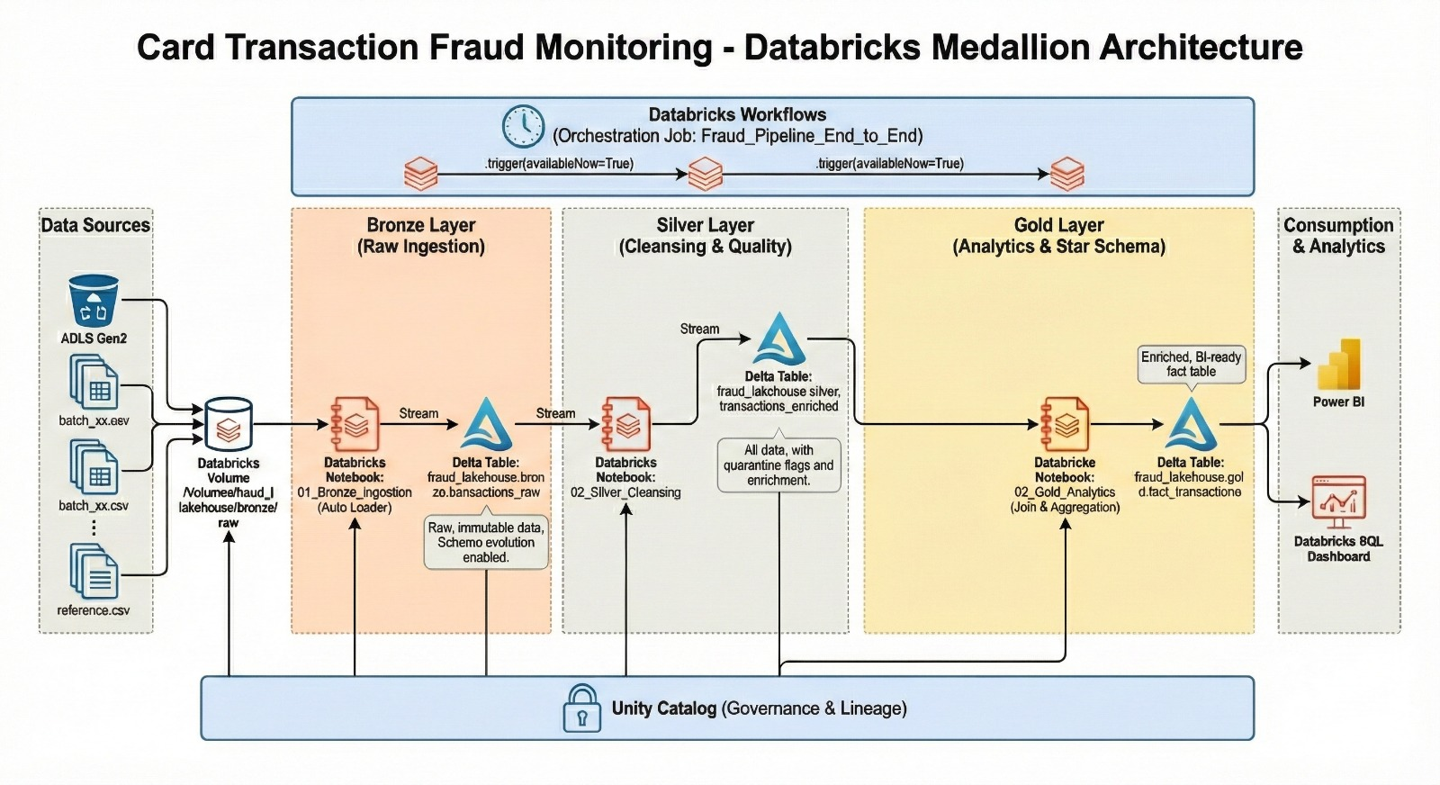
ARCHITECTURE DIAGRAM
Fig 1. Architecture

Slide 6
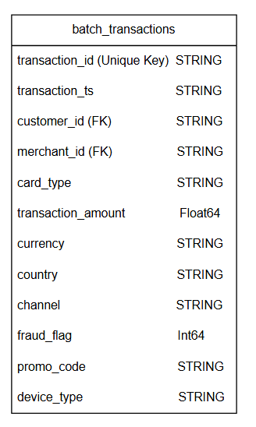
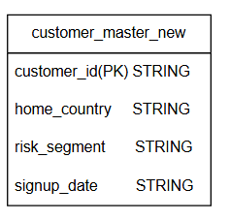
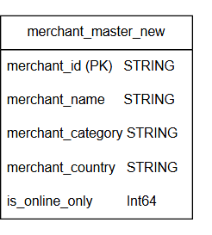
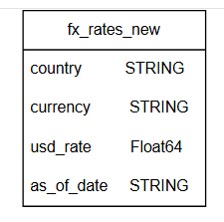
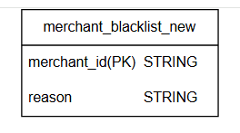
DATASET OVERVIEW
Fig 3. customer_master_new
Fig 5. merchant_master_new
Fig 2. batch_transactions
Fig 4. merchant_blacklist_new
Fig 6. fx_rates_new

Slide 7
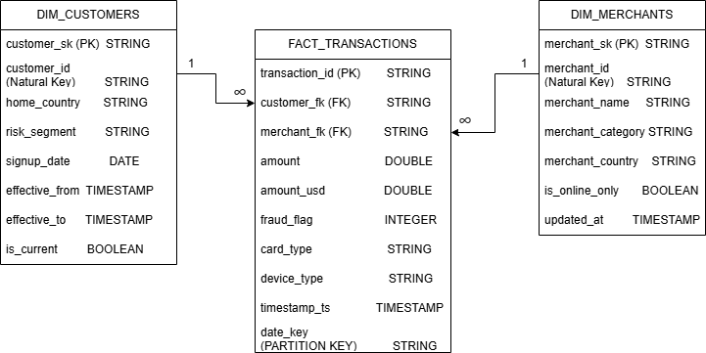
STAR SCHEMA
Fig 7. Star Schema

Slide 8
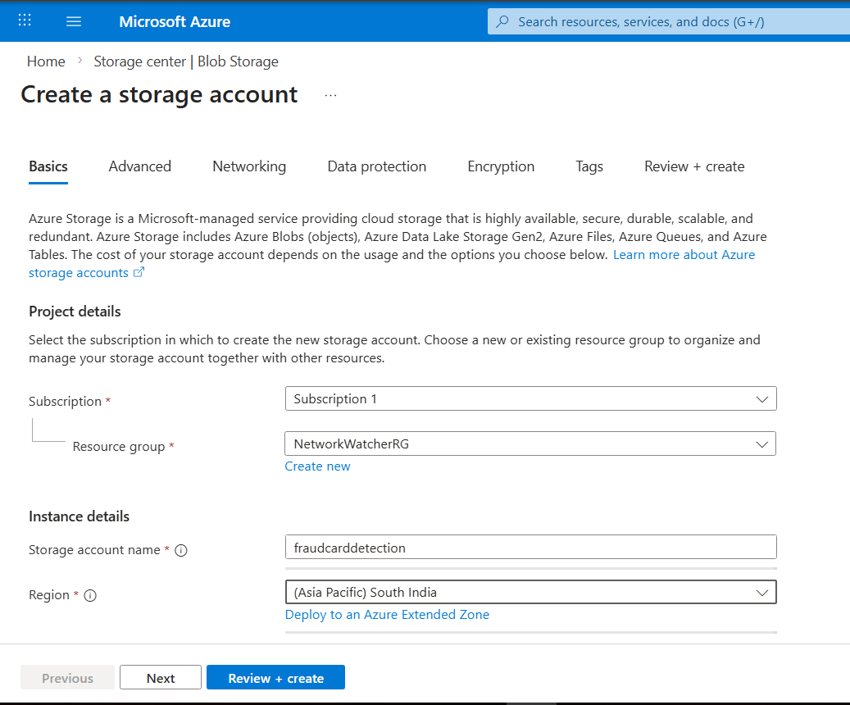
AZURE DATA LAKE STORAGE (ADLS)
ADLS : central landing zone for transactional and reference data, offering scalable, durable, and cost‑efficient storage.
Supports continuous ingestion using Auto Loader, enabling automatic file detection, historical backfill, and incremental processing.
Schema is inferred and evolves automatically, allowing new columns or structural changes without ingestion failures.
Ensures reliability and governance through high availability, secure IAM‑based access, and preservation of raw files for audit and replay needs.
In the Bronze layer, data from ADLS is ingested exactly as received into Delta, enabling decoupling of producers/consumers and efficient reprocessing aligned with Medallion Architecture.
Fig 8. Creating Storage Account

Slide 9
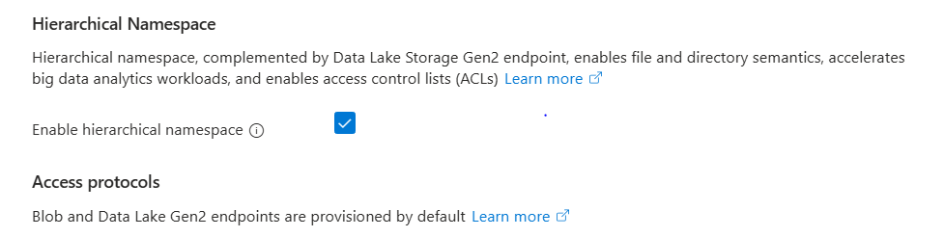
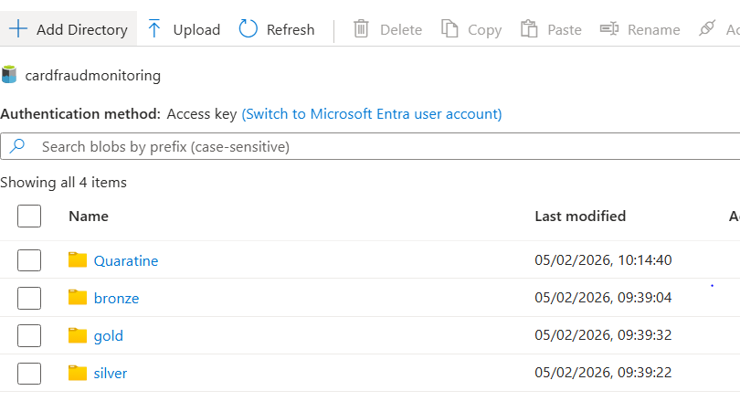
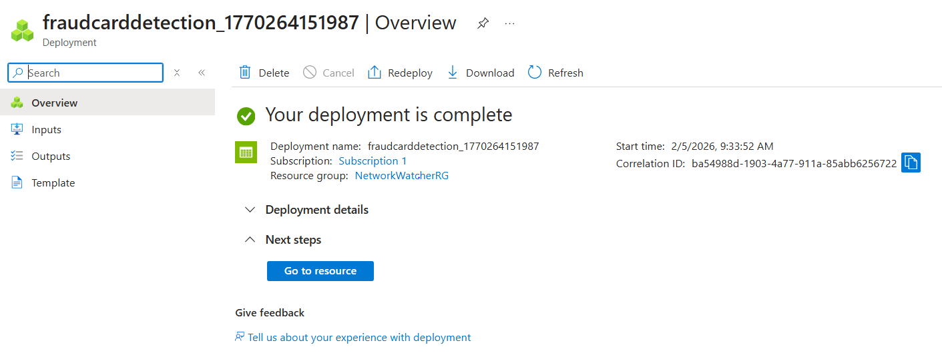
Enabling Hierarchical Namespace and Storage Account Creation
Fig 9. Enabling Hierarchical Namespace
Fig 11. File Hierarchy
Fig 10 . Successful Creation of Storage Account

Slide 10
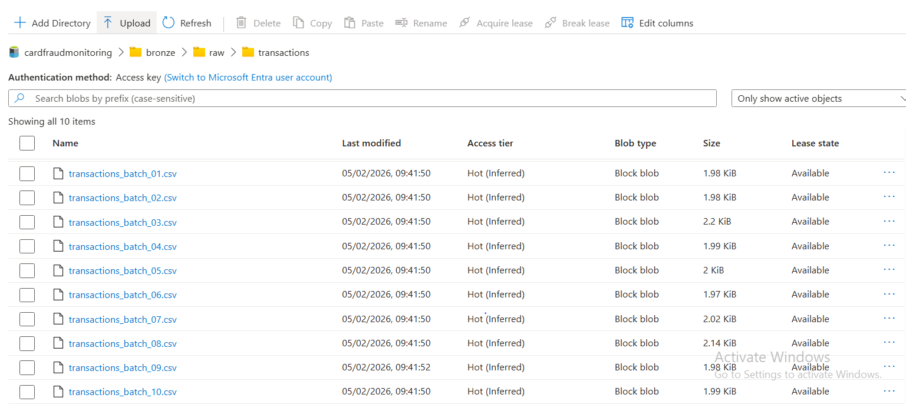
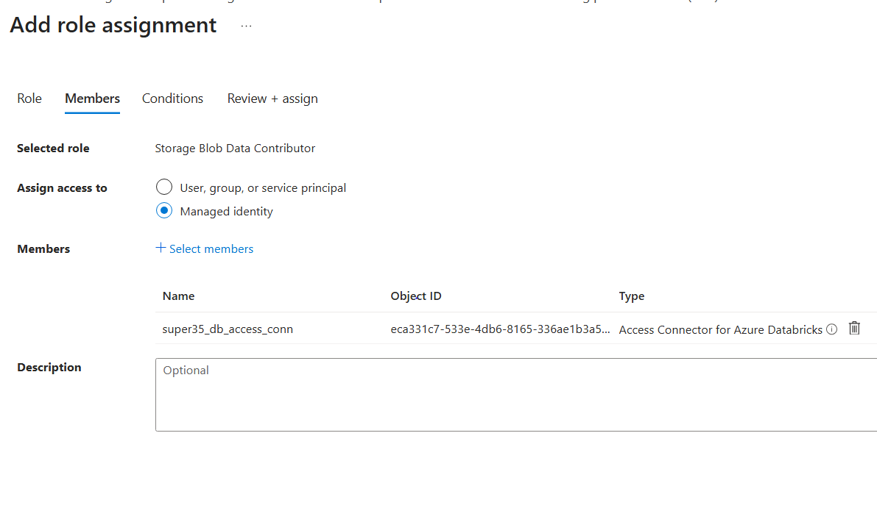
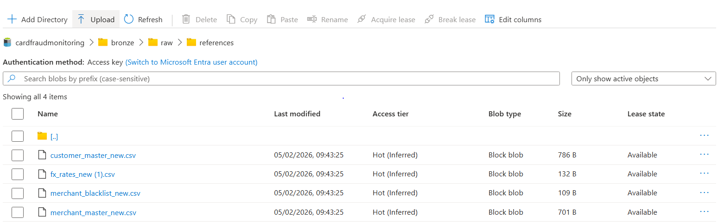
DATA UPLOADATION
Fig 12. Transaction Files
Fig 14. Role Assignment
Fig 13. Reference Files

Slide 11
BRONZE LAYER
Raw Ingestion
Implemented incremental file ingestion using Databricks Auto Loader (cloud_files)
Source: ADLS → Unity Catalog Volume → Bronze Delta Table
Storage format: Delta Lake for ACID compliance and time travel
Schema Management & Data Quality
Schema inference enabled (cloudFiles.inferColumnTypes = true)
Automatic schema evolution (schemaEvolutionMode = addNewColumns)
Malformed and unexpected records captured using rescued data column (_rescued_data)
Ensures schema drift tolerance
Metadata & Lineage
ingestion_timestamp → ingestion audit tracking
source_file → file-level lineage via _metadata.file_path
Ingestion Control
One-time micro-batch execution → trigger(availableNow=True)

Slide 12
SILVER LAYER
Objective
Improve data quality and reliability.
Enforce business rules and prepare data for analytics.
Cleansing , Standardization and Enrichment
Deduplication of transactions.
Primary and Foreign key validation with Auditing.
Handling NULL country and currency values.
Standardization of transactions amount (USD).
Outlier detection using IQR(IQR=Q3-Q1;UpperBound=Q3+1.5 x(Q3-Q1);flag if amount>upper bound)
Fraud flag enrichment.
Output
Cleaned and enriched Silver Transactions table.
Change Data Feed (CDF) enabled for incremental processing.

Slide 13
GOLD LAYER : Analytics and Optimization
Designed a Star Schema optimized for analytical queries, moving away from flat files to a relational model.
Architecture
Implemented a standard Fact-Dimension model.
Fact Table: fact_transactions (Contains metrics like amount, fraud_flag).
Dimensions: dim_customers and dim_merchants (Contain context).
SCD Type 2 (History Tracking) : Applied to dim_customers.
Technique
Used a "Hash Diff" approach. If a customer's risk_segment changes, we close the old record (is_current=False) and insert a new one. This allows us to analyze fraud based on the customer's risk level at the time of the transaction.
SCD Type 1 (Latest State): Applied to dim_merchants.
Technique
We keep only the latest details for merchants (overwriting old data) since merchant history was deemed less critical for this use case.
Surrogate Keys
Generated sk (hashed) keys (e.g., customer_sk) to uniquely identify rows and handle history, completely decoupling our warehouse from source system IDs.

Slide 14
GOLD LAYER - Optimization
Z-Ordering (Clustering)
  Code : OPTIMIZE fact_transactions ZORDER BY (customer_fk, merchant_fk)
  Benefit: Co-locates related data in the same physical files. This speeds up filtering by Customer or Merchant by skipping irrelevant files (Data Skipping).
Partitioning
  Code : .partitionBy("date_key")
  Benefit : Allows queries to target specific days (Partition Pruning) instead of scanning the entire history.
Broadcast Joins
  Code : .join(broadcast(dim_cust_active)…)
  Benefit : Sends the small Dimension tables to all worker nodes instantly, eliminating expensive "Shuffles" of the massive Fact table during the join.
CDC (Change Data Capture) via MERGE
  Code : MERGE INTO ... WHEN MATCHED UPDATE ...
  Benefit : Instead of rewriting the whole table every day, we only touch rows that changed or are new (Upsert strategy).

Slide 15
GOLD LAYER
Change Data Feed (CDF)
  Code: TBLPROPERTIES (delta.enableChangeDataFeed = true)
  Benefit: Enables downstream systems to stream only the changes from our Gold table, future-proofing the architecture.
Vacuum
  Code: VACUUM ... RETAIN 168 HOURS
  Benefit: Removes obsolete files to save storage costs and keep metadata clean.

Slide 16
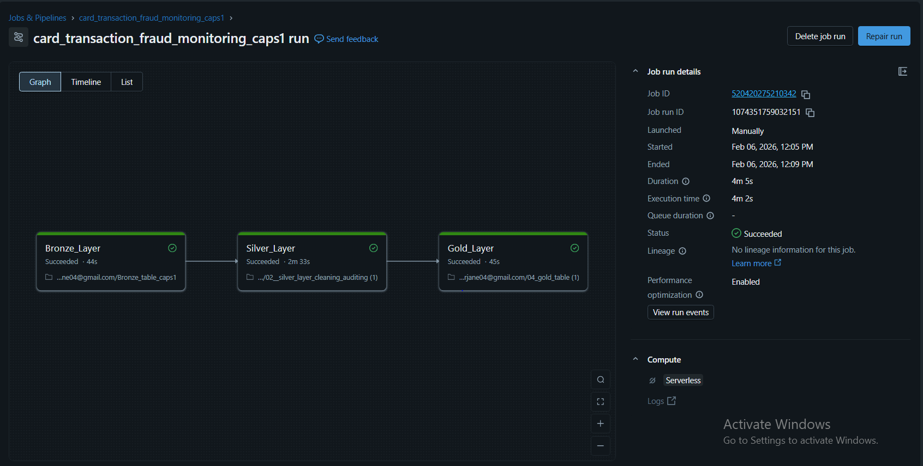
JOB RUN

Slide 17
BI DASHBOARD
For the visualization layer (Power BI), we made a specific architectural choice to ensure speed.
View Type : Materialized View (Pre-Aggregated Table)
  We did not use a standard "Normal View" (Virtual View). Querying the raw Fact table (millions of rows) every time a user opens the dashboard is too slow and costly.
Implementation : We created a physical Delta table bi_daily_sales_summary.
Result : The heavy aggregation logic (Sums, Averages, Counts) runs once in Databricks. Power BI then reads this tiny, pre-calculated table instantly.
Dashboard Components Built:
  Executive KPI View : Daily Sales, Fraud Rates, and Trends (Source: bi_daily_sales_summary).
  Operational Alert View : List of flagged transactions for immediate action (Source: suspicious_activity_report).
  Customer 360 View : Deep dive into individual customer behavior (Source: customer_360_profile).

Slide 18
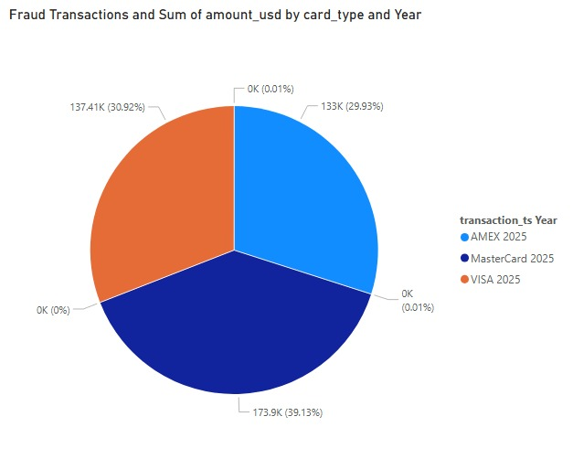
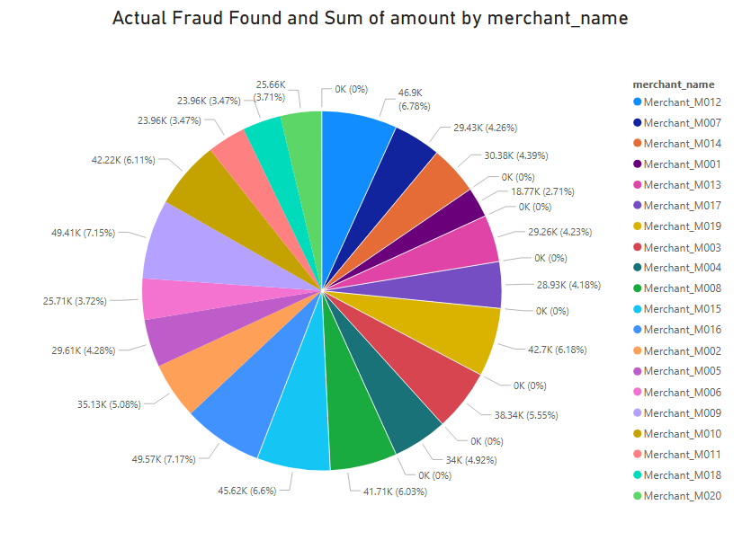
DASHBOARDS
Fig 15. Dashboard 1
Fig 16. Dashboard 2

Slide 19
CHALLENGES FACED
Schema Drift: Unexpected new columns caused pipeline breakages.
Data Quality Issues: Malformed records led to ingestion failures and risk of data loss.
Duplicate Ingestion: Re‑uploaded files created duplicate transaction records.
Loss of History: Standard updates overwrote historical customer profile changes.
Slow Query Performance: Large Fact tables caused sluggish joins with Dimensions.
High Dashboard Latency: Power BI queries on granular data were slow and costly.

Slide 20
THANK YOU

